Slide 1

CALCULUS
Chapter 6 TECHNIQUES OF INTEGRATION

Slide 2
6.1. Integration by Parts
6.2. Approximate Integration
6.3. Improper Integrals

Slide 3
6.1. Integration by Parts
In this section, we will learn:
How to integrate complex functions by parts.

Slide 4
INTEGRATION BY PARTS
Formula 1:
Let u = f (x) and v = g (x).
Then, the differentials are:
du = f ’(x) dx and dv = g’(x) dx.
Thus, by the Substitution Rule, the formula for integration by parts becomes:

Slide 5
INTEGRATION BY PARTS
Formula 6:
Evaluating both sides of Formula 1 between a and b, assuming f ’ and g’ are continuous, and using the FTC, we obtain:

Slide 6
INTEGRATION BY PARTS
Example 1:
Find ?
Let
Using Formula 2, we have:

Slide 7
INTEGRATION BY PARTS
Example 2:
Find ?

Slide 8
QUIZ…
Suppose f (x) is continuous and differentiable, f (1) = 4 and
Find
A. 4/5.
B. 5/4.
C. 1.
D. None of the others.
E. -1.

Slide 9
QUIZ…
Suppose f (x) is continuous and differentiable, f (1) = 3, f (3) = 1 and
What is the average value of f on the interval [1, 3]?

Slide 10
QUIZ…
Suppose f (x) is continuous and differentiable, f (1) = 3, f (3) = 1 and
What is the average value of f on the interval [1, 3]?

Slide 11
6.2. TECHNIQUES OF INTEGRATION Approximate Integration
In this section, we will learn:
How to find approximate values
of definite integrals.

Slide 12
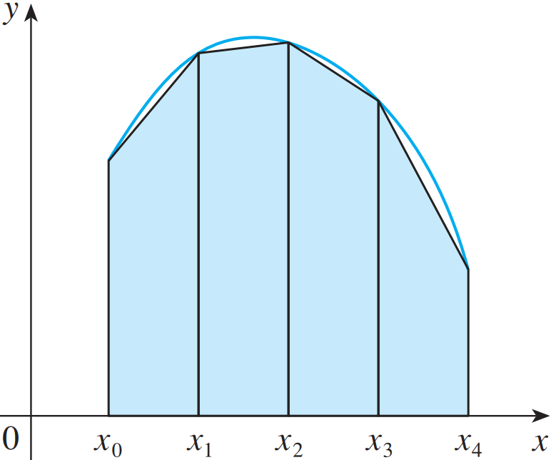
TRAPEZOIDAL RULE
The reason for the name can be seen from the figure, which illustrates the case f(x) ≥ 0.

Slide 13
TRAPEZOIDAL RULE
The area of the trapezoid that lies above the i th subinterval is:
If we add the areas of all these trapezoids, we get the right side of the Trapezoidal Rule.

Slide 14
TRAPEZOIDAL RULE

Slide 15
TRAPEZOIDAL RULE
where ∆x = (b – a)/n
and x_{i} = a + i ∆x, i = 1,2,…, n.

Slide 16
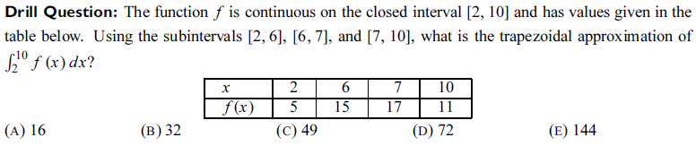
QUIZ…

Slide 17
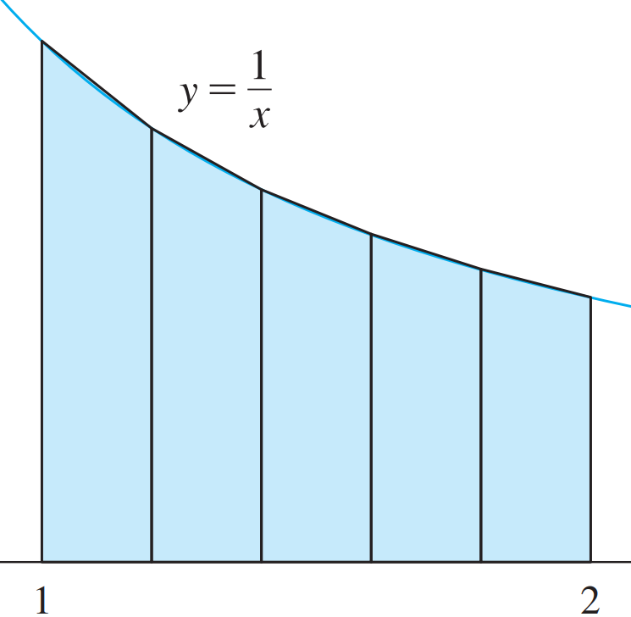
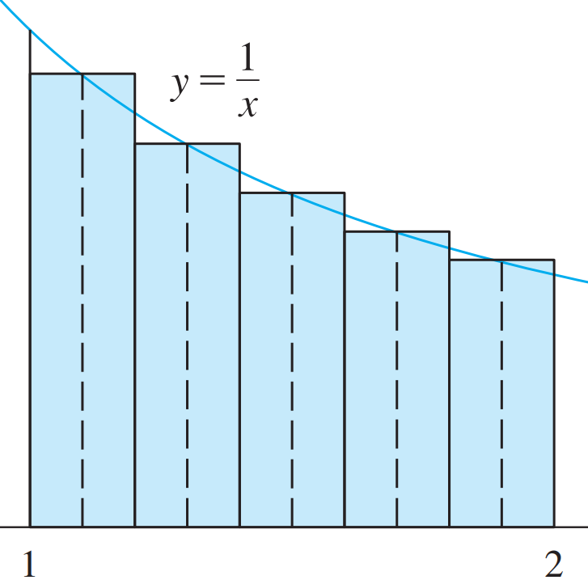
EXAMPLE
Approximate the integral
with n = 5, using:
a. Trapezoidal Rule
b. Midpoint Rule

Slide 18
EXAMPLE
a) With n = 5, a = 1 and b = 2, we have:
∆x = (2 – 1)/5 = 0.2
1; 1.2; 1.4; 1.6; 1.8; 2.
So, the Trapezoidal Rule gives:

Slide 19
EXAMPLE
b) So, the Midpoint Rule gives:

Slide 20
ERROR BOUNDS
Estimate 3
Suppose | f’’(x) | ≤ K for a ≤ x ≤ b.
If E_{T} and E_{M} are the errors in the Trapezoidal and Midpoint Rules, then

Slide 21
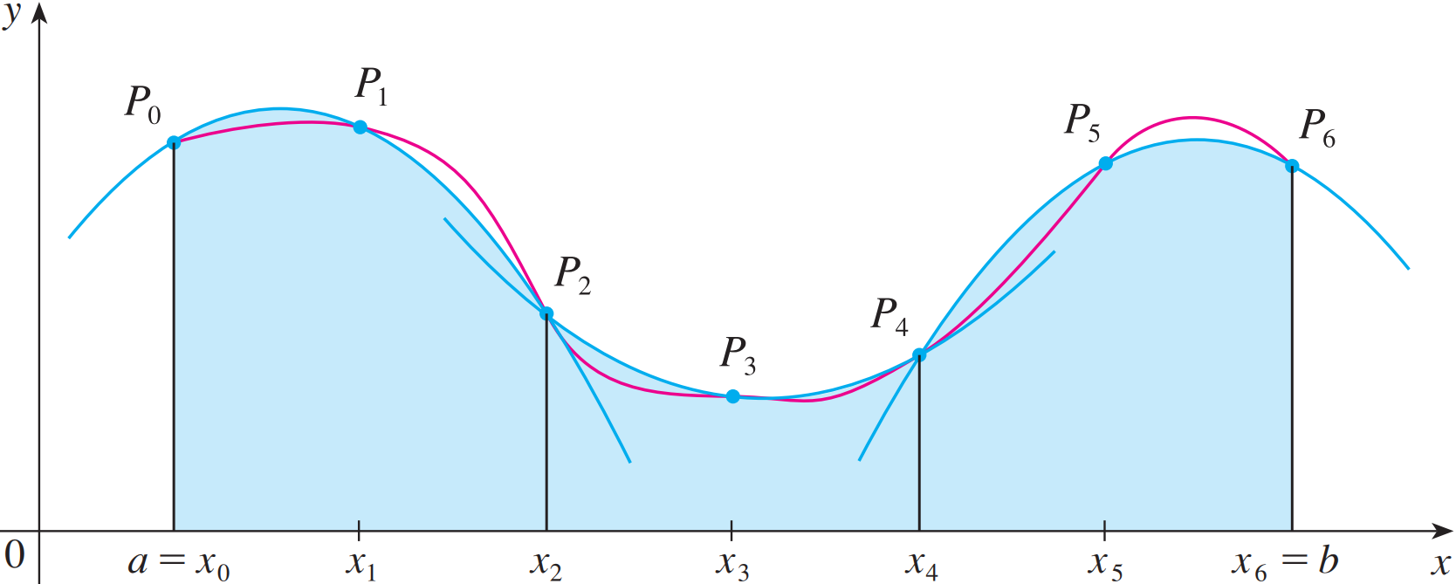
SIMPSON’S RULE
This is called Simpson’s Rule—after the English mathematician Thomas Simpson (1710–1761).
where n is even
and ∆x = (b – a)/n.

Slide 22



APPROXIMATE INTEGRATION
This means that the area under the parabola through P₀, P₁, and P₂ from x = x₀ to x = x₂ is still:
where n is even
and ∆x = (b – a)/n.

Slide 23
APPROXIMATE INTEGRATION

Slide 24
ERROR BOUND (SIMPSON’S RULE)
Estimate 4
Suppose that | f ⁽⁴⁾(x) | ≤ K for a ≤ x ≤ b.
If E_{s} is the error involved in using Simpson’s Rule, then

Slide 25
SIMPSON’S RULE
Example: Use Simpson’s Rule with n = 10 to approximate
Putting f (x) = 1/x, n = 10, and ∆x = 0.1 in Simpson’s Rule, we obtain:

Slide 26
SIMPSON’S RULE
In Example 4, notice that Simpson’s Rule gives a much better approximation (S₁₀ ≈ 0.693150) to the true value of the integral (ln 2 ≈ 0.693147) than does either:
Trapezoidal Rule (T₁₀ ≈ 0.693771)
Midpoint Rule (M₁₀ ≈ 0.692835)

Slide 27
6.3. TECHNIQUES OF INTEGRATION IMPROPER INTEGRAL
In this section, we will learn:
How to solve definite integrals
where the interval is infinite and where the function has an infinite discontinuity.
Notes:
Thế nào là tích phân suy rộng loại I, II?
Một định nghĩa cẩn thận về sự hội tụ và phân kỳ liên quan đến các tích phân suy rộng của loại I, II.
Tiêu chuẩn so sánh để xác định rằng tích phân suy rộng hội tụ và phân kỳ.

Slide 28
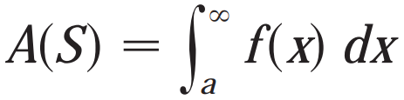
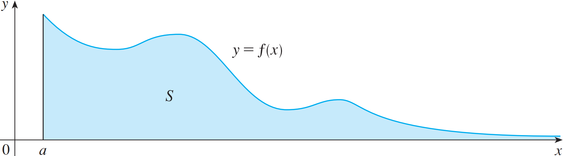

Slide 29
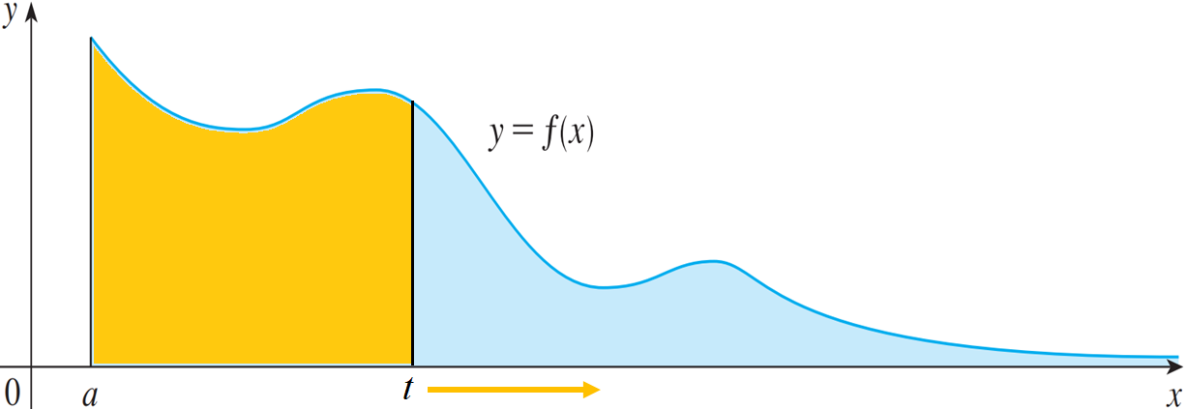
IMPROPER INTEGRAL OF TYPE 1
Definition 1a:
If exists for every number t ≥ a, then
provided this limit exists (as a finite number).

Slide 30
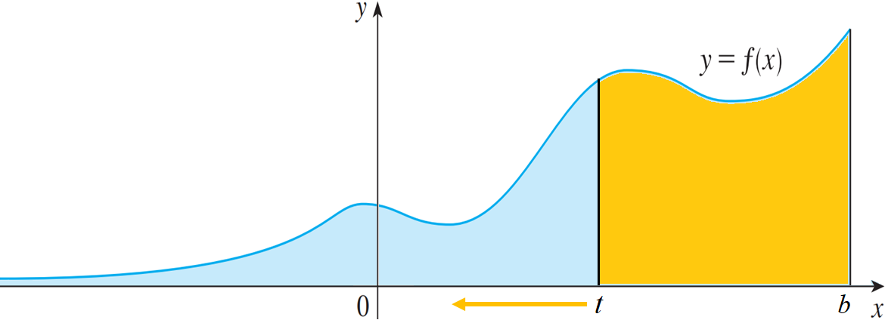
IMPROPER INTEGRAL OF TYPE 1
Definition 1b:
If exists for every number t ≤ b, then
provided this limit exists (as a finite number).

Slide 31
CONVERGENT AND DIVERGENT
Definition 1b:
The improper integrals and are called:
Convergent if the corresponding limit exists.
Divergent if the limit does not exist.

Slide 32
IMPROPER INTEGRALS OF TYPE 1
Example 4:
For what values of p is the integral convergent ?
We know from Example 1 that, if p = 1, the integral is divergent.
So, let’s assume that p ≠ 1.

Slide 33
IMPROPER INTEGRALS OF TYPE 1
Definition 2:
We summarize the result of Example 4 for future reference:
is:
Convergent if p > 1
Divergent if p ≤ 1

Slide 34
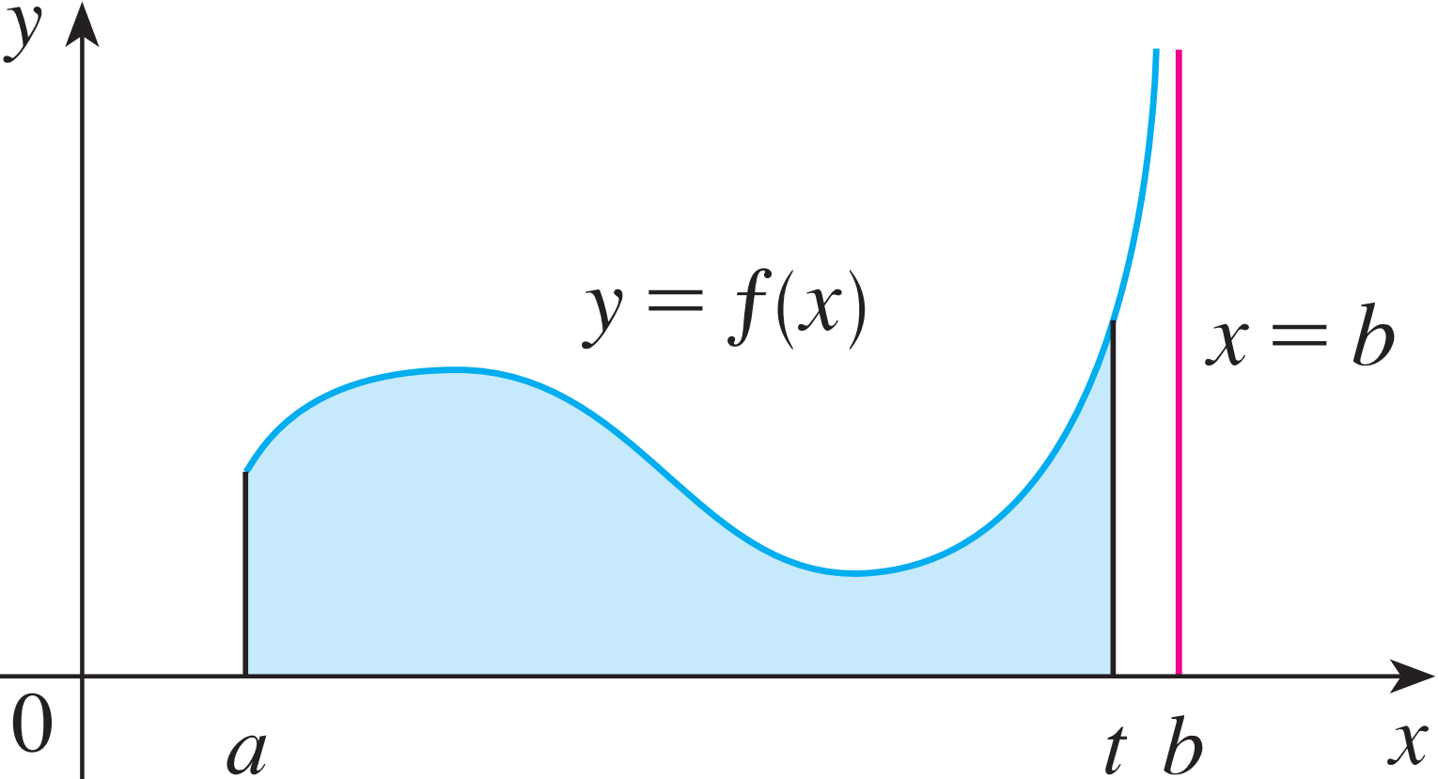
IMPROPER INTEGRALS OF TYPE 2
Definition 3a:
If f is continuous on [a, b) and is discontinuous at b
then
if this limit exists (as a finite number).

Slide 35
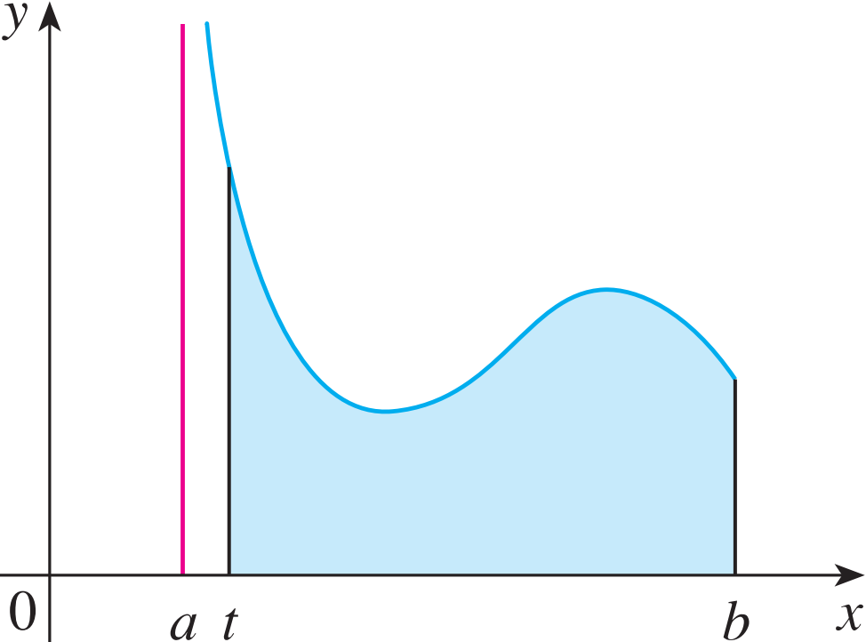
IMPROPER INTEGRALS OF TYPE 2
Definition 3a:
If f is continuous on (a, b] and is discontinuous at a
then
if this limit exists (as a finite number).

Slide 36
IMPROPER INTEGRALS OF TYPE 2
Definition 3b:
The improper integral is called:
Convergent if the corresponding limit exists.
Divergent if the limit does not exist.

Slide 37
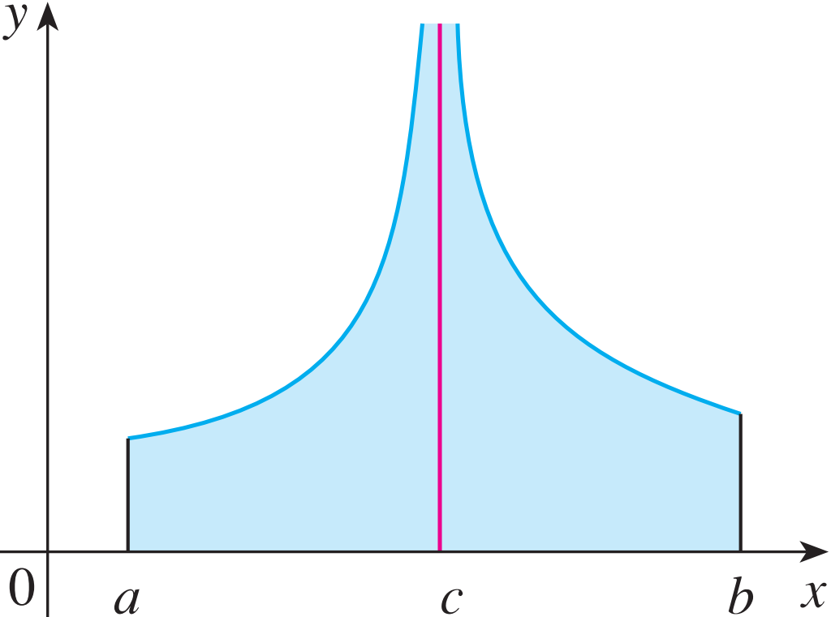
IMPROPER INTEGRALS OF TYPE 2
Definition 3c:
If f has a discontinuity at c, where a < c < b, and both and are convergent, then we define:

Slide 38
COMPARISON THEOREM
Theorem:
Suppose f and g are continuous functions with f(x) ≥ g(x) ≥ 0 for x ≥ a.
If is convergent, then is convergent.
If is divergent, then is divergent.

